Slide 1


PSIRT Case Data Trends
13 February 2017
Harold Toomey | Sr. Product Security Architect & PSIRT Manager, ISecG, Intel

Slide 2

Agenda
Who am I?
Metrics
  PSIRT
  3rd Party
  SDL
  PSMM

Slide 3




Intel Security Product Security Group (PSG)
Intel: ~105K employees & ~110K CWs
ISecG / McAfee: ~8K employees
McAfee is breaking off on 3 April 2017
PSG has a core team of 4 Principal / Senior Security Architects
Satellite teams
80 Sr. Security Architects (PSCs)
30 Security Engineers (PSEs)
5 Years of PSIRT data for 136 McAfee product lines
James
Brook
Stephen
Harold
PSCs & PSEs

Slide 4


Introduction
Responsibilities
    Manage Satellite team of 80 Sr. Security Architects (PSCs)
    PSIRT Manager & CVE Numbering Authority
    Agile SDL / Product Security Maturity Model (PSMM)
    Tools, Training & Privacy Support
    Policies / Procedures
    Operations: Metrics / Reporting / Websites / Email DLs
Experience
    5 Years: Software / Application Security
    2 Years: IT Operational Security
    11 Years: Enterprise Product Management
    10 Years: Software Development (C++)
ISSA North Texas Chapter, Past President
CISSP, CISA, CISM, CRISC, CGEIT, ITIL, CNE, …
Harold Toomey
Sr. Product Security Architect
Notes:
Good afternoon.
My name is Harold Toomey.
I work for Intel Security.
I am here with my manager, Dr. James Ransome.
I have worked for McAfee/Intel Security for the past 9 years.
Before that I worked for Symantec for 8 years.
For the past 4 years I have worked in software security.
I manage our PSIRT team as well as other SDL programs.
┘

Slide 5


















Satellite Team of PSCs
  Key:
  AMR = American Region
  GAM = Greater Americas Region
  NAR = North American Region
  LAR = Latin American Region
  GER = Greater Europe Region
  EUR = European Region
  META = Middle East, Turkey, Africa
  GAR = Greater Asia Region
  RCIS = Russia and Commonwealth of Independent States
  SEA = Southeast Asia
NAR
RCIS
$$⋆$$
$$⋆$$
$$⋆$$
$$⋆$$
EUR
$$⋆$$
$$⋆$$
$$⋆$$
GER
$$⋆$$
$$⋆$$
$$⋆$$
$$⋆$$
$$⋆$$
$$⋆$$
$$⋆$$
GAR
META
$$⋆$$
AMR
$$⋆$$
LAR
SEA
$$⋆$$
Notes:
https://intelpedia.intel.com/Intel_Geos_and_Regions
https://intelpedia.intel.com/Intel_Acronyms

Slide 6



PSIRT Metrics

Slide 7
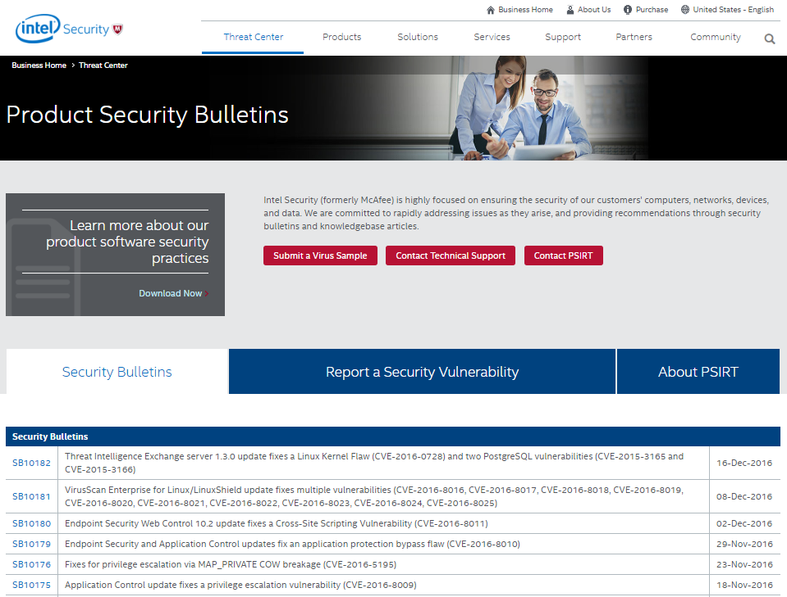
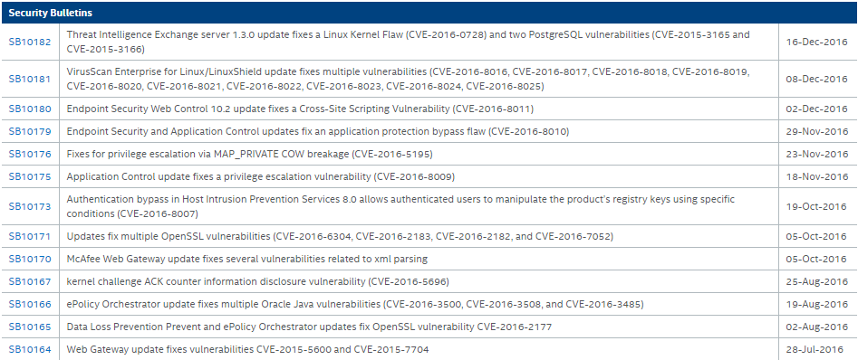
PSIRT Home Page – Public Record
https://www.mcafee.com/us/threat-center/product-security-bulletins.aspx

Slide 8

Metrics Chart Formats Key
SB Format
  By # of Security Bulletins
  1 SB may contain multiple products and/or multiple vulnerabilities
Product Format
  By # of Vulnerable Products
  1 product may contain multiple vulnerabilities
Vulnerability Format
  By # of Unique Vulnerabilities
  1 vulnerability may be in many products

Slide 9
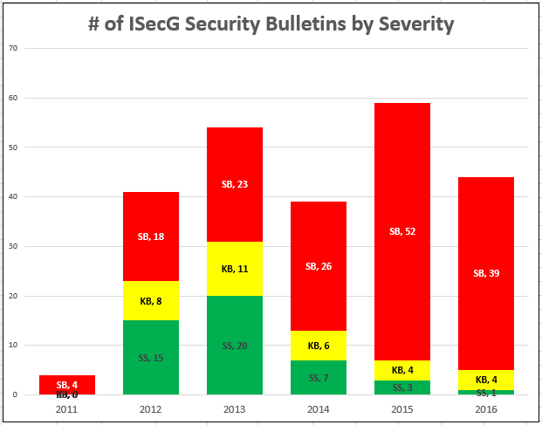
PSIRT – Security Bulletins by Type
  KEY
    SB = Security Bulletin
    KB = Knowledgebase Article
    SS = Sustaining Statement
SB Format
  By # of actual SBs published
  Observations:
  1 in 5 PSIRT cases (20%) result in an SB
  PSIRT team size impacts this
    2011 → 2012 [1 → 4]
    2014 → 2015 [FT PSIRT Eng.]
Source: ISecG PSIRT as of 12 Feb 2017
Notes:
ISecG
Metrics show all open PSIRT cases, not just those resulting in published security bulletins
ISecG tracks PSIRT cases more granularly than mother Intel, e.g. 1 vuln. per product vs. 1 vuln. per BU
~2% of vulns. are double counted in both PSIRT databases
58% of the vulnerabilities are from 3rd party and open source libraries
Spike in 2015 due to OpenSSL vulnerabilities [Heartbleed /POODLE] - 137 total
Only 14% are internally found vulns. since most are only tracked in Bugzilla
In 2015 ISecG shipped more products than all other Intel BUs combined
Current portfolio contains 136 product lines
2015 PSIRT incidents declined significantly, likely due to the PSG’s proactive activities including: training, mentoring, security reviews, and tool usage.

Slide 10
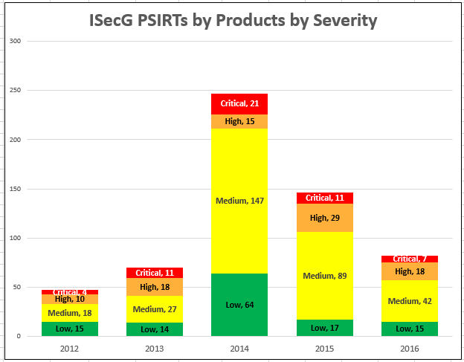
PSIRT – Vulnerable Products by Severity
Product Format
  By # of Vulnerable Products / patches or hotfixes
  Observations:
  Critical vulnerabilities cut in half each of the last 3 years
  Engineering is likely delivering more secure products (Our SDL is working!)
Source: ISecG PSIRT as of 12 Feb 2017
Notes:
ISecG
Metrics show all open PSIRT cases, not just those resulting in published security bulletins
ISecG tracks PSIRT cases more granularly than mother Intel, e.g. 1 vuln. per product vs. 1 vuln. per BU
~2% of vulns. are double counted in both PSIRT databases
58% of the vulnerabilities are from 3rd party and open source libraries
Spike in 2015 due to OpenSSL vulnerabilities [Heartbleed /POODLE] - 137 total
Only 14% are internally found vulns. since most are only tracked in Bugzilla
In 2015 ISecG shipped more products than all other Intel BUs combined
Current portfolio contains 136 product lines
2015 PSIRT incidents declined significantly, likely due to the PSG’s proactive activities including: training, mentoring, security reviews, and tool usage.

Slide 11
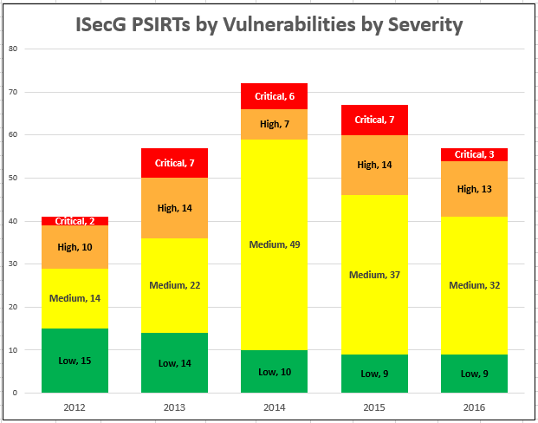
PSIRT – Vulnerabilities by Severity
Vulnerability Format
  By # of unique vulnerabilities
  Observations:
  Downward tend for the past 3 years (this is good)
  50% less critical PSIRT cases in 2016 vs. 2015 (also good)
Source: ISecG PSIRT as of 12 Feb 2017

Slide 12
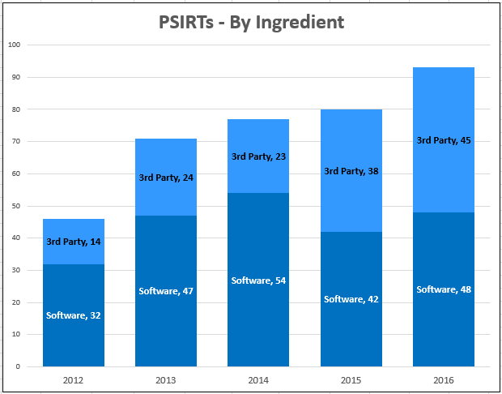
PSIRTs – By Ingredient
Ingredient Format
  3rd Party vs. Our own code
  Observations:
  5 year upward trend in PSIRT cases
  Almost 50%-50% mix last 2 years
  3rd party broken out in a later set of slides
    Software = # product vulnerabilities reported externally (PSIRT) that had previously been found internally (Bugzilla)
Source: ISecG PSIRT as of 12 Feb 2017
Notes:
Talking Points/Trends:
This metric reports how many product vulnerabilities were reported externally (PSIRT) that had previously been found internally (Bugzilla)
This is a new metric for ISecG. We will be gathering this info from our PSCs.

Slide 13
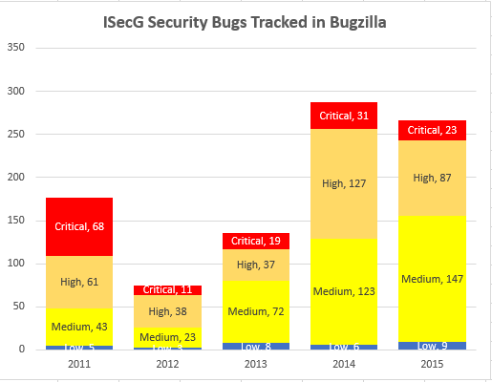
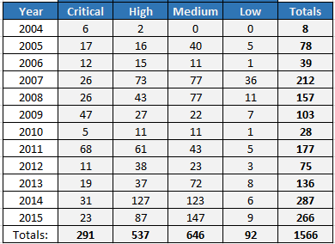
All Vulnerabilities Found and Fixed in Shipping Products

Slide 14
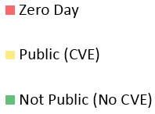

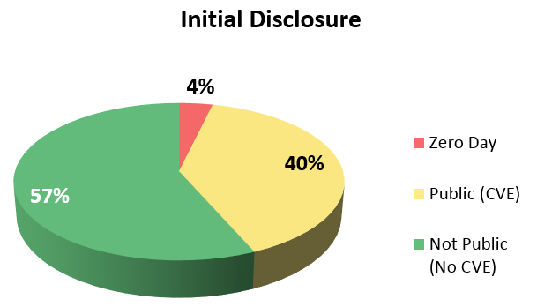
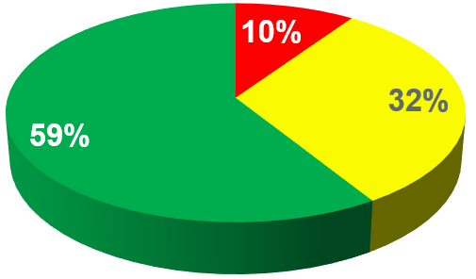
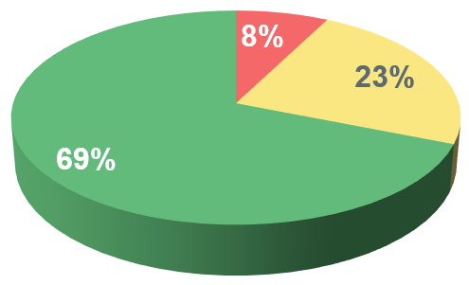
PSIRT – Sources of Vulnerabilities
2013 2014 2016
Source: ISecG PSIRT as of 12 Feb 2017

Slide 15
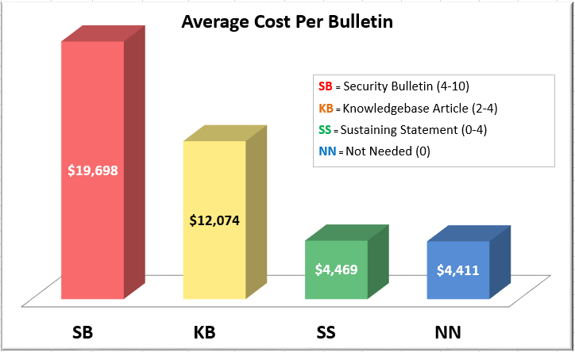
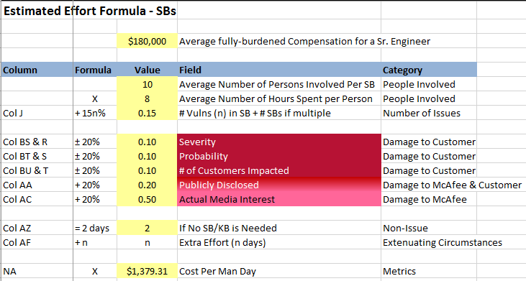
PSIRT Cost Estimates (lower bound)

Slide 16

3rd Party Libraries / Open Source
Products vulnerable from using 3rd party libraries and Open Source

Slide 17




OpenSSL Vulnerabilities
Date | Description | # Vuln. Products | SB
11 May 2012 | CVE-2012-2110 | 1 | KB75482
28 Jan 2013 | CVE-2013-6450 | 1
8 Apr 2014 | Heartbleed | 19 | SB10071
2 Jun 2014 | Heartbleed II | 22 | SB10075
9 Jun 2014 | GnuTLS Buffer Overflow | 1 | SB10078
16 Apr 2014 | CVE-2014-3511 | 1 | SB10084
22 Aug 2014 | CVE-2014-3507 | 1 | SB10105
14 Oct 2014 | POODLE | 28 | SB10090
14 Oct 2014 | 3 SSLv3 CVEs | 16 | SB10091
9 Jan 2015 | 8 OpenSSL CVEs | 2 | SB10102
4 Mar 2015 | FREAK | 6 | SB10108
18 Mar 2015 | CVE-2014-3507 | 1 | SB10109
19 Mar 2015 | 14 OpenSSL CVEs | 24 | SB10110
Date | Description | # Vuln. Products | SB
8 Jun 2015 | 7 OpenSSL CVEs | 11 | SB10122
9 Jul 2015 | CVE-2015-1793 | 3 | SB10125
3 Dec 2015 | 4 OpenSSL CVEs | 6 | KB86280
8 Dec 2015 | CVE-2015-3194 | 1
28 Jan 2016 | CVE-2015-3197 | 1
1 Mar 2016 | DROWN | 2 | SB10154
3 May 2016 | 6 OpenSSL CVEs | 9 | SB10160
21 Jul 2016 | CVE-2016-2177 | 1 | SB10165
25 Aug 2016 | CVE-2016-2183 | 2 | SB10171
26 Sep 2016 | 16 OpenSSL CVEs | 4 | SB10165 SB10171
31 Jan 2017 | CVE-2017-3732 CVE-2016-7055 | 1 | CVE
Total: 164

Slide 18



Other Named Vulnerabilities
Linux/UNIX/glibc (Not OpenSSL)
Date | Description | # Vuln. Products | SB
20 Aug 2013 | CVE-2009-3736: glibc CVE-2012-0864: glibc | 2 | SS
24 Sep 2014 | Shellshock/BASH | 23 | SB10085
27 Jan 2015 | GHOST | 31 | SB10100
19 Jan 2016 | CVE-2016-0728 | 3 | KB86557
16 Feb 2016 | CVE-2015-7547: glibc | 17 | SB10150
13 Jun 2016 | CVE-2016-4429: glibc | 1
12 Aug 2016 | CVE-2016-5696: Kernel | 1 | SB10167
24 Oct 2016 | DIRTY COW | 2 | SB10176 SB10177
Total: 79

Slide 19

NTP Vulnerabilities
Date | Description | # Vuln. Products | SB
14 Jan 2014 | CVE-2013-5211 | 6
19 Dec 2014 | NTP & FREAK (8 CVEs) | 6 | SB10108
24 Mar 2015 | CVE-2015-1798 CVE-2015-1799 | 2 | SB10114
30 Jun 2015 | CVE-2015-5146 CVE-2014-9298 | 1
22 Oct 2015 | NTP – CERT VU#403656 (21 CVEs) | 3 | SB10162
30 May 2016 | NTP – CERT VU#321640 (5 CVEs) | 2
21 Nov 2016 | CVE-2016-7433 (9 CVEs) | 5
Most NTP vulnerabilities are for MFE & MWG
Total: 25

Slide 20

Oracle Java Vulnerabilities
Date | Description | # Vuln. | SB
9 Apr 2013 | CVE-2013-1493 | 1 | SS871943
9 Apr 2013 | CVE-2013-0809 | 1 | SS871947
10 Sep 2013 | 4 CVEs: CVE-2013-2461 | 1 | KB1309101
5 Mar 2013 | App. exposes sensitive data in Java stack traces | 1 | SB10053
19 Aug 2013 | 4 Java CVEs | 1 | KB
15 Oct 2013 | Oct 15th Oracle Java Bulletin | 1 | SB10058
15 Jan 2014 | Jan 2014 Java Update 51 | 1
15 Apr 2014 | Apr 2014 Oracle Java Bulletin | 1 | SB10072
15 Jul 2014 | Jul 2014 Oracle Java Bulletin | 1 | SB10083
10 Oct 2014 | Oct 2014 Oracle Java Update | 1 | SB10092
14 Apr 2015 | Apr 2015 Oracle Java Bulletin | 1
14 Jul 2015 | Jul 2015 update Java 8.0 | 1 | SB10139
Date | Description | # Vuln. Products | SB
20 Oct 2015 | Oct 2015 update Java 8.0 | 1 | SB10141
15 Jan 2016 | Jan 2016 update Java 8.0 | 1 | SB10148
19 Apr 2016 | Apr 2016 update Java 8.0 | 1 | SB10159
19 July 2016 | Jul 2016 update Java 8.0 | 1 | SB10166
17 Jan 2017 | Jan 2017 update Java 8.0 | 1 | SB10186
Total: 17
NOTE: The only product directly affected is ePO

Slide 21

DNS / BIND Vulnerabilities
Date | Description | # Vuln. Products | SB
1 Aug 2012 | ISC BIND CVE-2012-1667 | 4 | SB10030 SB10033 SB10034
2 Aug 2012 | ISC BIND CVE-2012-3817 ISC BIND CVE-2012-1033 | 1 | SB10032
27 Sep 2012 | Bind CVE-2012-4244 | 1 | SB10035
23 Jul 2013 | BIND CVE-2013-4854 | 4 | SB10052
12 Feb 2015 | BIND CVE-2015-1349 | 1 | SB10116
8 Jul 2015 | BIND CVE-2015-4620 | 1 | SB10124
28 Jul 2015 | BIND CVE-2015-5477 | 1 | SB10126
3 Sep 2015 | BIND DNS CVE-2015-5722 BIND DNS CVE-2015-5896 | 3 | SB10134
26 Jan 2016 | BIND CVE-2015-8704 | 1
All BIND vulnerabilities are for:
McAfee Firewall Enterprise (MFE)
McAfee Email Gateway (MEG)
Total: 17

Slide 22

RSA BSAFE Vulnerabilities
Date | Description | # Vuln. Products | SB
29 Aug 2012 | MS Critical Update KB 2661254 | 1 | SS792316
19 Sep 2013 | RSA Security Advisory: ESA-2013-068: RSA BSAFE | 3 | SB10067
19 Feb 2014 | RSA Security Advisory: ESA-2014-009: RSA BSAFE SSL-J (4 CVEs) | 3
30 Dec 2014 | RSA BSAFE® Micro Edition Suite and SSL-J Triple Handshake Vulnerability | 3
12 May 2015 | Crypto-J/SSL-J 6.1.x. Libs | 5
13 Apr 2016 | CVE-2016-0887 | 2
Total: 17

Slide 23

SDL Metrics
PSC Staffing Levels, Agile SDL Dashboards, PSMM

Slide 24
Product Security Champion Staffing Levels
    PSC staffing levels per product group
Goal
90% staffed per product group
80 PSCs
136 Supported Products
Source: Example Data Only
Notes:
36 Consumer Mobile products
7 currently listed
29 missing
% Filled # Prods # PSCs
Management 100% 20 19
Endpoint 82% 17 14
Network 75% 12 9
Content 84% 16 13.5 Dave Oxley is acting PSC BU Lead = 0.5
McAfee Labs 60% 10 6
Consumer 86% 7 6 Missing Consumer BU Lead

Slide 25
Agile SDL
Dashboards
Technical | Operational
SDL.T01 Security Definition of Done (DOD) | SDL.O01 Program
SDL.T02 Security Architecture Review | SDL.O02 SDL
SDL.T03 Security Design Review | SDL.O03 PSIRT
SDL.T04 Threat Modeling | SDL.O04 Tools and Services
SDL.T05 Security Testing / Validation | SDL.O05 Resources
SDL.T06 Static Analysis | SDL.O06 Policy and Compliance
SDL.T07 Dynamic Analysis (Web Apps) | SDL.O07 Process
SDL.T08 Fuzz Testing | SDL.O08 Training
SDL.T09 Vulnerability Scan | SDL.O09 Metrics
SDL.T10 Penetration Testing
SDL.T11 Manual Code Review
SDL.T12 Secure Coding Standards
SDL.T13 Open Source and 3rd Party Libraries
SDL.T14 Vendor Management
SDL.T15 Privacy
SDL.T16 Operating Environment
Daily
Scrum
Development
& Test

Slide 26
When? Technical Activities

Slide 27
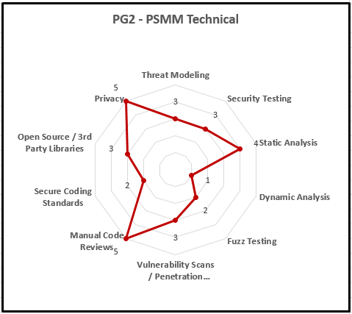

Product Security Maturity Model (PSMM)
None, Minimal, Good, Better, Best
  Maturity levels
    0. None
    1. Basic
    2. Initial
    3. Acceptable
    4. Mature
  Math
Set team goal for each SDL activity
Measure 2x a year and report
$$(9+16)×4=100$$

Slide 28
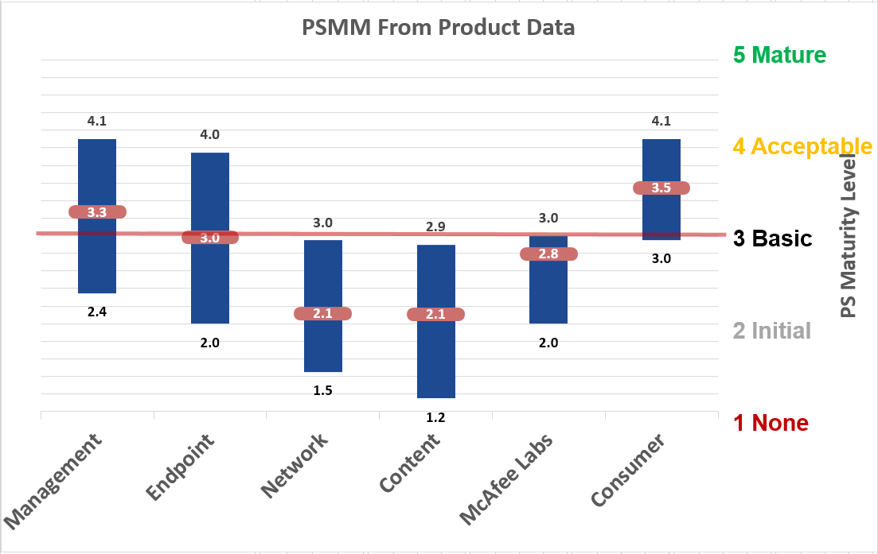
Product Security Maturity Model (PSMM) (cont.)
This metric indicates how well the product security program is running.
Updated every 6 – 12 months
Book in the works
Product
Group A B C D E F
Source: ISecG PSG in 2015
Notes:
PSMM Score
==========================
SMBU 3.5 [1.5-4.5]
Endpoint BU 3.0 [2.5-3.5]
Network BU 3.5 [2.5-4.5]
Content BU 3.0 [1.5-4.5]
McAfee Labs BU 3.8 [3.0-4.0]
Consumer BU 3.0 [1.5-3.5]
1 None
2 Initial
3 Basic
4 Acceptable
5 Mature
We meet the average but not the outliers.
Estimates now, based on hard data in future.
Labs went from 0 to 3.8 in 3 years.
From ad-hoc and some activity (1) to MM of 3 broadly across BUs as a program (3.5).

Slide 29


Q&A
Harold Toomey
Sr. Product Security Architect
Product Security Group
Intel Security (McAfee)
Harold.A.Toomey@Intel.com
Harold_Toomey@McAfee.com
W: (972) 963-7754
M: (801) 830-9987

